Slide 1
Simple Review
Asymptotic Growth
  Ω-notation
  Θ-notation
Recurrences
  Substitution method
  Recursion-tree method
  Master method

Slide 2
Design and Analysis of Algorithms
Heapsort (Ch6)

Slide 3
Design and Analysis of Algorithms
Heaps and Heapsort
Topics:
Heaps
Heapsort
Priority queue

Slide 4
Recap and overview
The story so far…
--Insertion sort running time of Θ(n²); sorts in place
--Merge sort running time of Θ(n lg n); needs auxiliary storage Θ(n).
Next…
--Heapsort running time of Θ(n lg n); sort in place.
--Quicksort running time of Θ(n lg n) on average; most practical (and hence widely-used) sorting algorithm.
--Sorting in linear time.
Notes:
Recap：扼要重述
auxiliary：辅助的

Slide 5

Heaps
Data structure indexed by integers 1, 2, …, n.
Each element supports the operation PARENT, LEFT, RIGHT.
Easily implemented using an array with PARENT(i) = , LEFT(i) = 2i, and RIGHT(i) = 2i + 1.
max heap A[PARENT(i)] ≥ A[i]
min heap A[PARENT(i)] ≤ A[i]
The root of the heap is A[1]. The height of a node is the longest downward path from the node to a leaf. The height of the heap is the height of the root.

Slide 6
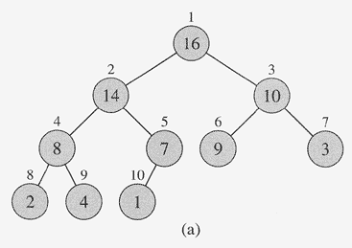
Heaps
Viewed as a binary tree, it is completely filled on all levels except possibly the last.
PARENT(i) = , LEFT(i) = 2i, and RIGHT(i) = 2i + 1.
1 | 2 | 3 | 4 | 5 | 6 | 7 | 8 | 9 | 10
16 | 14 | 10 | 8 | 7 | 9 | 3 | 2 | 4 | 1

Slide 7

Heaps
Exercise. The height of heap with n elements is
Operations supported by a heap:
MAX-HEAPIFY ensures that a heap is max heap. O(log n)
BUILD-MAX-HEAP produces a max heap from an unordered array. Θ(n)
To sort an array, we can first convert it into a max heap, repeatedly extract the root (the largest element by definition) and MAX-HEAPIFY the rest. Θ(n log n)

Slide 8
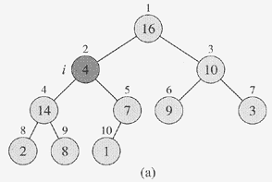
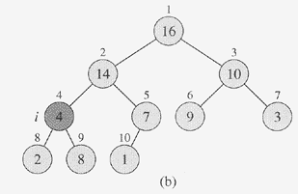
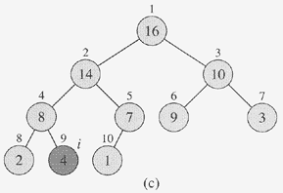
MAX-HEAPIFY
(a) The initial with A[2] at node i = 2 violating the max-heap property
(b) By exchange A[2] with A[4], which
Destroys the max-heap property for node 4. Recursive call MAX-HEAPIFY(A,4) has i = 4…
(c) MAX-HEAPFIFY(A,9) yields no further change to the data structure.

Slide 9
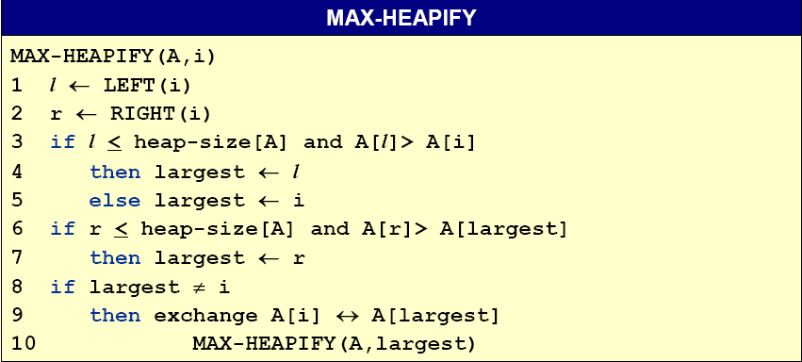
MAX-HEAPIFY
heap-size[A] keeps track of the size of the heap stored in the array A.
Running time: O(h), where h is the height of element A[i].

Slide 10
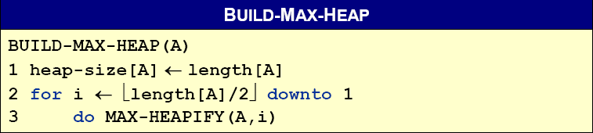

BUILD-MAX-HEAP
Loop invariant. At the start of the for loop, the nodes i + 1, i + 2,…, n each roots of a max-heap.
Initialization. Before the first iteration, i = . Since the nodes + 1,…, n are leaves, they are each roots of a max-heap.
Maintenance. The children of node i are numbered higher than i , so by the loop-invariant, they are both roots of a max-heap. MAX-HEAPIFY(A,i) will then make the tree rooted at node i a max-heap.
Termination. i = 0.
Notes:
可首先验证 length[A]/2是最后一个有孩子的结点：它肯定有孩子，而其后面的没有孩子

Slide 11
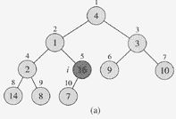
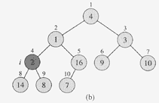
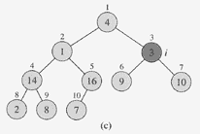
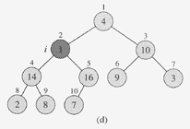
Action of BUILD-MAX-HEAP

Slide 12
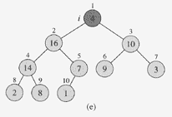
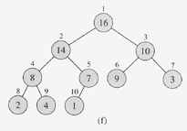
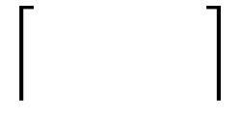
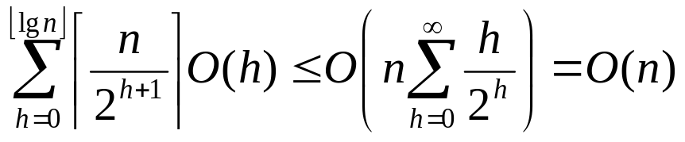
Action of BUILD-MAX-HEAP
Running time. The naive analysis leads to O(nlgn) .
Key observation. An n-element heap has at most n/2^{h+1}
nodes of height h (Exercise) and MAX-HEAPIFY require O(h) time to run on a node of height h. The running time is thus bounded by:

Slide 13
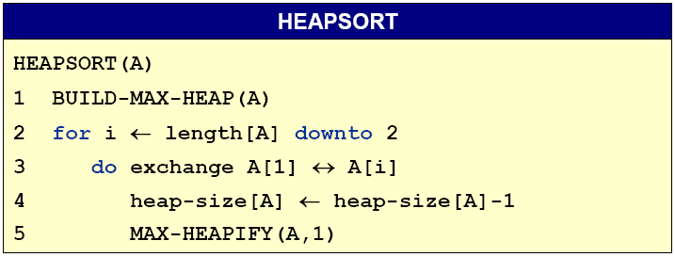
HEAPSORT
Running time. O(nlgn) The call to BUILD-MAX-HEAP takes time O(n) and there are n – 1 calls to MAX-HEAPIFY, each taking O(lgn) time.
In-place. Not Stable.
Note that even if BUILD-MAX-HEAP ran in O(nlgn) time, we’d get the same running time.

Slide 14
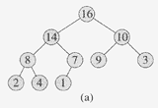
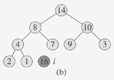
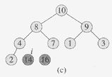
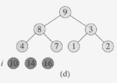
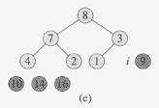
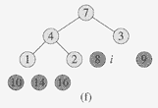
An Example for HEAPSORT

Slide 15
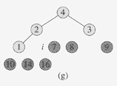
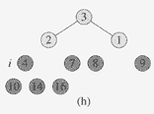
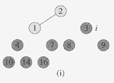
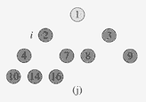

An Example for HEAPSORT
The resulting sort array A

Slide 16
Priority Queues
Heapsort is an excellent algorithm, but a good implementation of quicksort usually beats it in practice. Nevertheless, the heap data structure itself has enormous utility.
Priority Queues: a data structure for maintaining a set S of elements, each with an associated value called a key.
There are two kinds of priority queues: max-priority queues and min-priority queues. We’ll focus on here how to implement max-priority queues, which based on max-heaps.

Slide 17
Priority Queues
Max-priority queues applications.
--Schedule jobs on a shared computer
>>Keeping track of the jobs and their relative priorities
--Heapsort
>>implementing a priority queue
Min-priority queues applications.
--Dijkstra’s shortest path algorithm.
--Prim’s MST algorithm
--Event-driven simulation.
>>prioritizing events to be processed based on their predicted time of occurrence
--Huffman encoding.
--…

Slide 18
Priority Queues
Support the following basic operations.
--INSERT(S, x)
>>inserts the element x into S
--MAXIMUM(S)
>>returns the element of S with the largest key
--EXTRACT-MAX(S)
>>removes and returns the element of S with the largest key
--INCREASE-KEY(S, x, k)
>>Increase the value of key of element x to the new value k.

Slide 19
Simple Review
Heap Sort
  Heaps
  MAX-HEAPIFY
  BUILD-MAX-HEAP
  HEAPSORT
Priority Queues

Slide 20
Priority Queues
Support the following basic operations.
--INSERT(S, x)
>>inserts the element x into S
--MAXIMUM(S)
>>returns the element of S with the largest key
--EXTRACT-MAX(S)
>>removes and returns the element of S with the largest key
--INCREASE-KEY(S, x, k)
>>Increase the value of key of element x to the new value k.

Slide 21
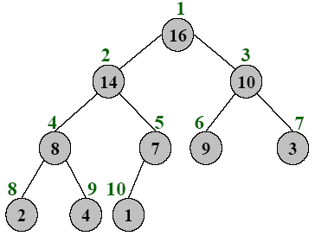

Max Binary Heaps
Operations supported.
--MAX-HEAPIFY ensures that a heap is max heap. O(logn)
--BUILD-MAX-HEAP produces a max heap from an unordered array. Θ(n)
--We will use these operations to simulate a priority queue.

Slide 22
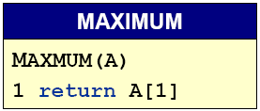
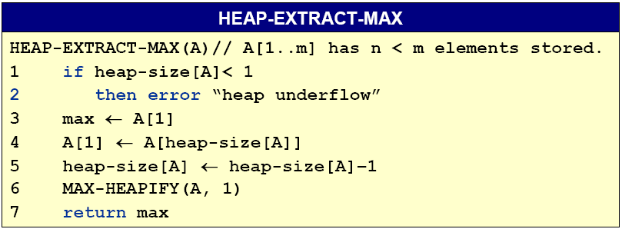
Priority queue operations using binary heaps
We have constant time access to the maximum.
Extracting the max element takes O(log n) time.

Slide 23
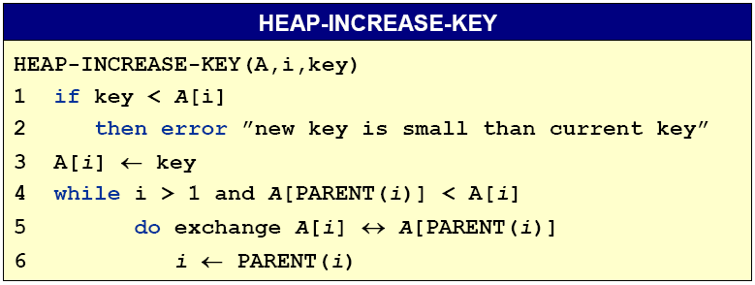
INCREASE-KEY
The running time proportional to the depth (distance from root) of the node, which is O(log n).

Slide 24
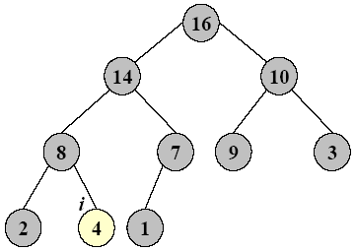
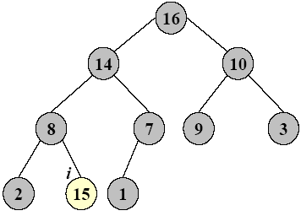
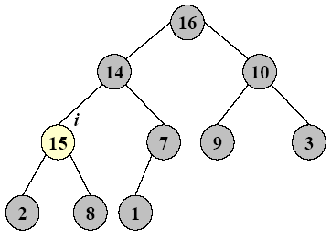
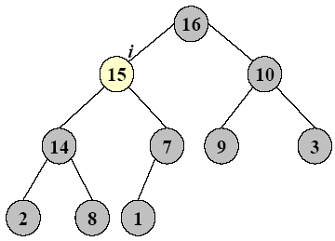
HEAP-INCREASE-KEY

Slide 25
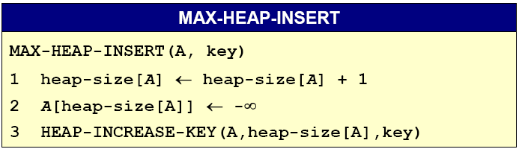
HEAP-INSERT
Runs in Θ(log n) time
All operations on an n-element heap take O(log n).

Slide 26
Homework
6.1-6，6.2-1

